Slide 1

Lecture 4
Entity-Relationship Modeling (Part 1)
UECS 1203
DATABASE SYSTEM FUNDAMENTALS

Slide 2
Exercise – ER Model
A company called Perfect Pets runs a number of clinics. A clinic has many staff and a member of staff manages at most one clinic (not all staff manage clinics). Each clinic has a unique clinic number and each member of staff has a unique staff number.

Slide 3
Exercise – ER Model
When a pet owner contacts a clinic, the owner’s pet is registered with the clinic. An owner can own one or more pets, but a pet can only register with one clinic. Each owner has a unique owner number and each pet has a unique pet number.

Slide 4
ER modeling
Top-down approach to database design.
Start by identifying the important data (called entities) and relationships between the data.

Slide 5
ER modeling
Then add more details such as the information we want to hold about the entities and relationships (called attributes) and any constraints on the entities, relationships, and attributes.

Slide 6
Entities
Entity
  A set of objects with the same properties, which are identified by a user or organization as having an independent existence.
Entity occurrence
  Each uniquely identifiable object within a set.

Slide 7
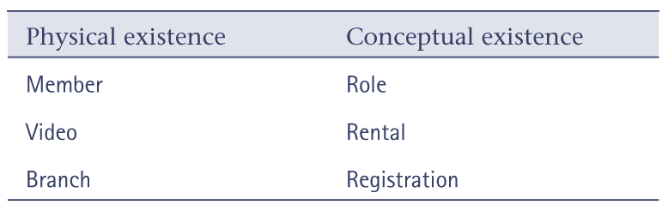
Entities with physical and conceptual existence

Slide 8
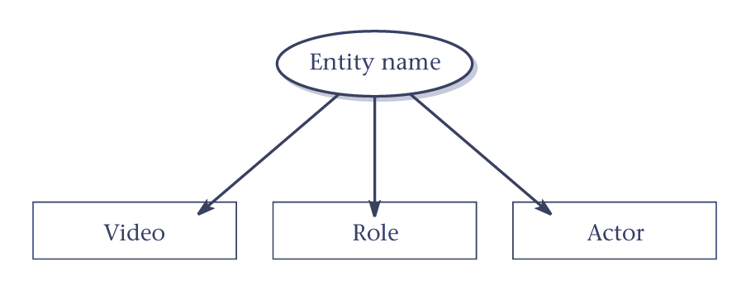
ER diagram of entities

Slide 9
Relationships
Relationship
  A set of meaningful associations among entities.
Relationship occurrence
  Each uniquely identifiable association within a set.

Slide 10
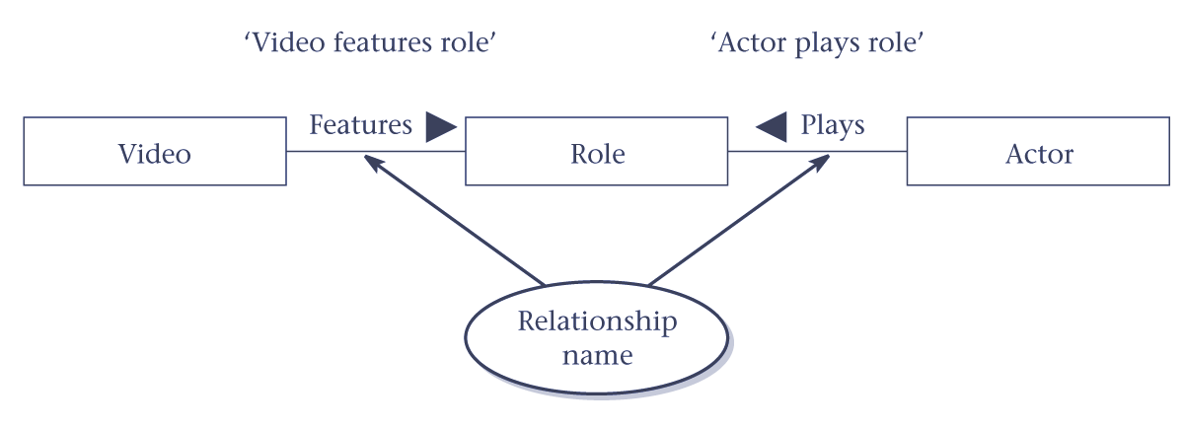
ER diagram of relationships

Slide 11
Relationships
Degree of a relationship
  Number of participating entities in relationship.
Relationship of degree :
  two is binary
  three is ternary
  four is quaternary.

Slide 12
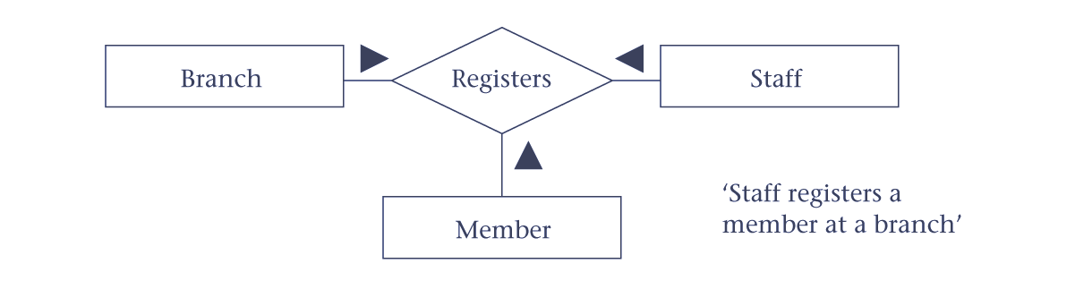
Example of ternary relationship

Slide 13
Recursive relationships
Relationship where same entity participates more than once in different roles.
Relationships may be given role names to indicate purpose that each participating entity plays in a relationship.

Slide 14
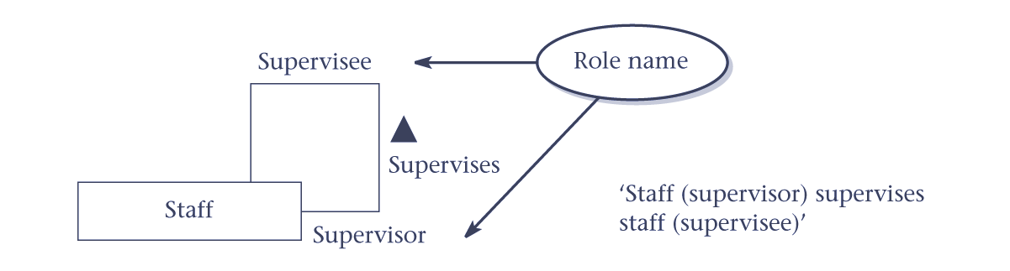
Example of a recursive relationship

Slide 15
Attributes
Property of an entity or a relationship.
Hold values that describe each occurrence of an entity or relationship, and represent the main source of data stored in the database.

Slide 16
Attributes
Attribute can be classified as being:
  simple or composite
  single-valued or multi-valued
  or derived

Slide 17
Attributes
Simple attribute
  Attribute composed of a single component.
Composite attribute
  Attribute composed of multiple components.

Slide 18
Attributes
Single-valued attribute
  Attribute that holds a single value for an entity occurrence.
Multi-valued attribute
  Attribute that holds multiple values for an entity occurrence.

Slide 19
Attributes
Derived attribute
  Attribute that represents a value that is derivable from value of a related attribute, or set of attributes, not necessarily in the same entity.

Slide 20
Keys
Superkey
  An attribute, or set of attributes, that uniquely identifies each entity occurrence.
Candidate key
  A superkey that contains only the minimum number of attributes necessary for unique identification of each entity occurrence.

Slide 21
Keys
Primary key
  The candidate key that is selected to identify each entity occurrence.
Alternate key
  The candidate keys that are not selected as the primary key of the entity.

Slide 22
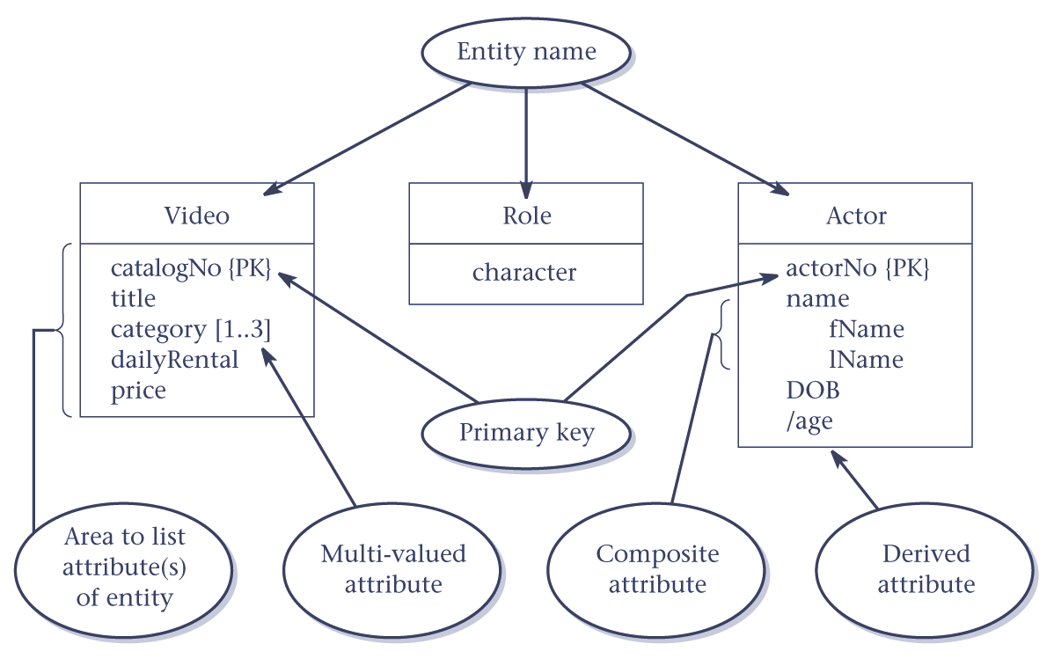
ER diagram of entities and their attributes

Slide 23
Strong and weak entities
Strong entity
  Entity that is not dependent on the existence of another entity for its primary key.
Weak entity
  Entity that is partially or wholly dependent on the existence of another entity, or entities, for its primary key.

Slide 24
Multiplicity constraints on relationships
Represents the number of occurrences of one entity that may relate to a single occurrence of an associated entity.
Represents policies (called business rules) established by user or company.

Slide 25
Multiplicity constraints
The most common degree for relationships is binary.
Binary relationships are generally referred to as being:
  one-to-one (1:1)
  one-to-many (1:*)
  many-to-many (*:*)

Slide 26
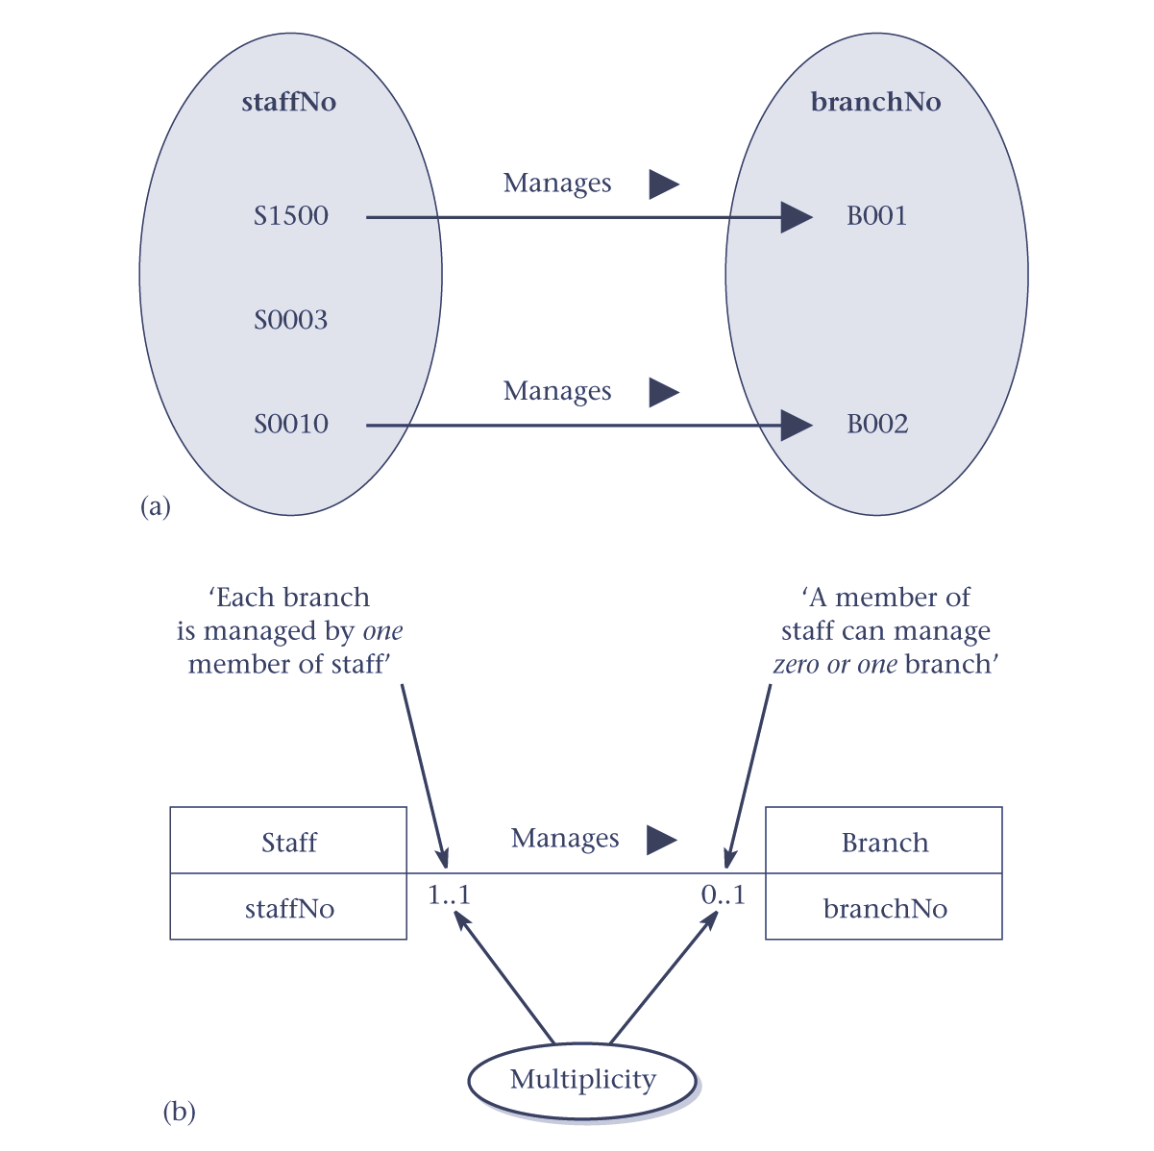
1:1 relationship
– individual examples

Slide 27
1:1 relationship
– multiplicity

Slide 28
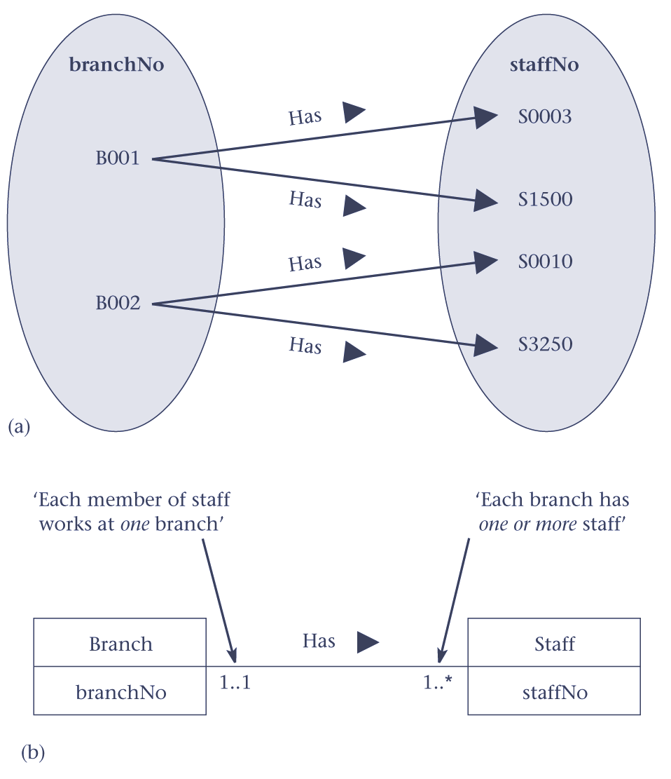
1:* relationship
– individual examples

Slide 29
1:* relationship
– multiplicity

Slide 30
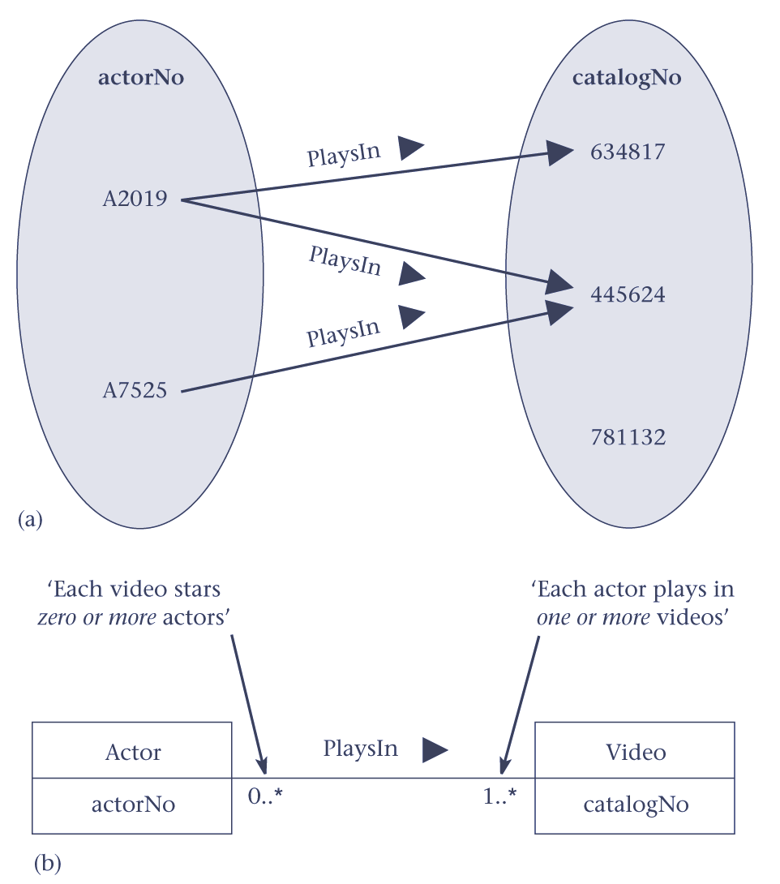
*:* relationship
– individual examples

Slide 31
*:* relationship
– multiplicity

Slide 32
Complex relationships
Multiplicity is the number (or range) of possible occurrences of an entity type in an n-ary relationship when other (n-1) values are fixed.

Slide 33
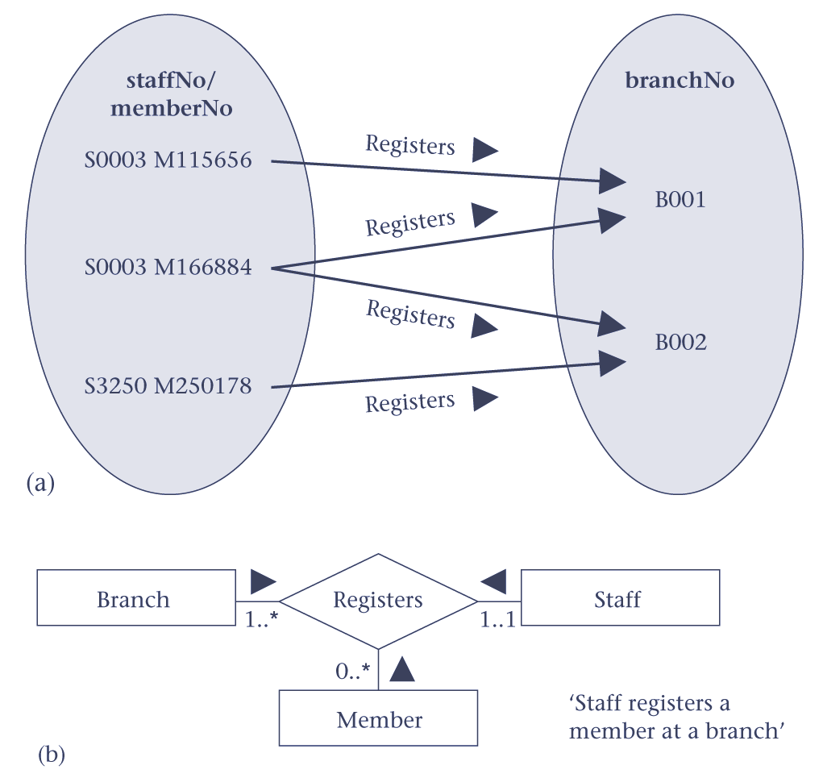
Complex relationship
– individual examples

Slide 34
Complex relationship
– multiplicity

Slide 35
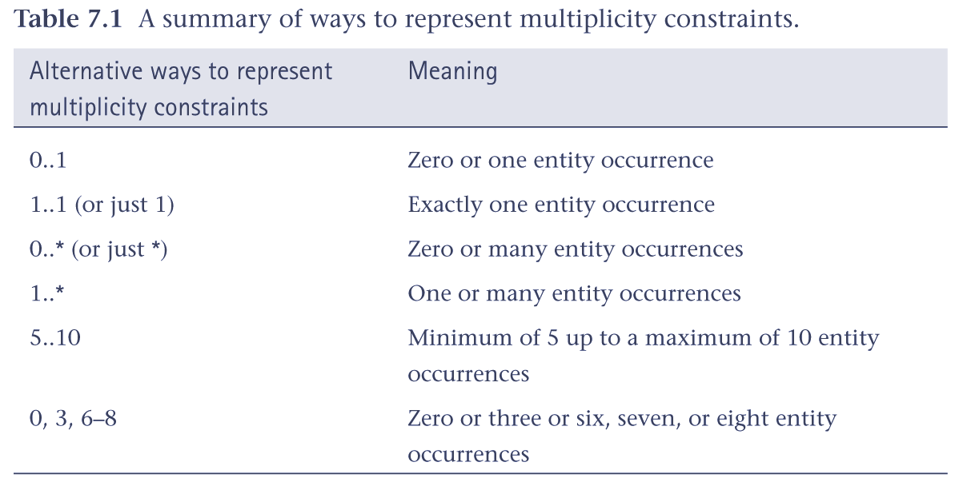
Summary of multiplicity constraints

Slide 36
Multiplicity
Made up of two types of restrictions on relationships:
  cardinality
  and participation

Slide 37
Multiplicity
Cardinality
  Describes the number of possible relationships for each participating entity.
Participation
  Determines whether all or only some entity occurrences participate in a relationship.

Slide 38
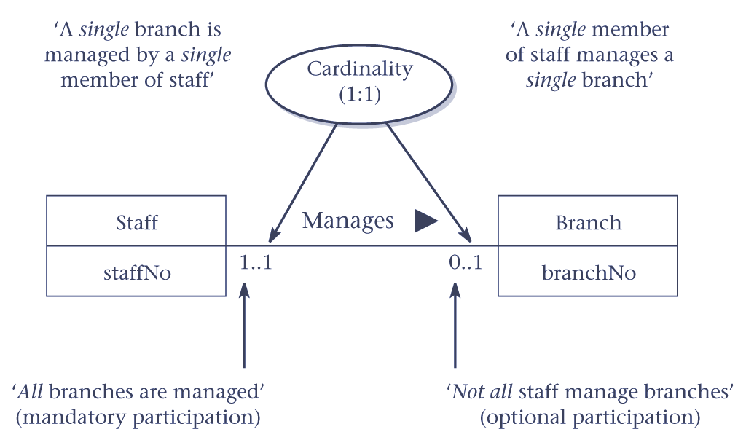
Multiplicity as cardinality and participation constraints

Slide 39
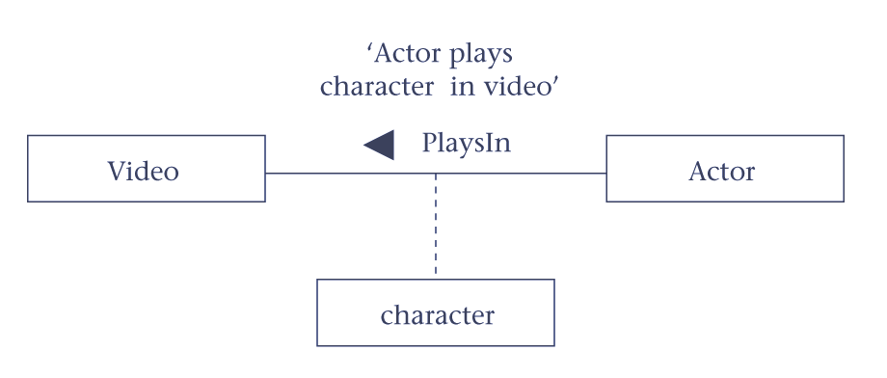
Relationship with attributes

Slide 40
Problems with ER models
Problems may arise when designing an ER model called connection traps.
Often due to a misinterpretation of the meaning of certain relationships.
Two main types of connection traps are called fan traps and chasm traps.

Slide 41
Problems with ER models
Fan trap
  Two entities have a 1:* relationship that fan out from a third entity, but the two entities should have a direct relationship between them to provide the necessary information.

Slide 42
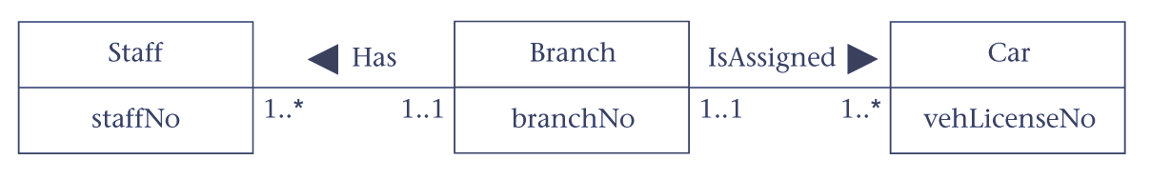
An example of a fan trap

Slide 43
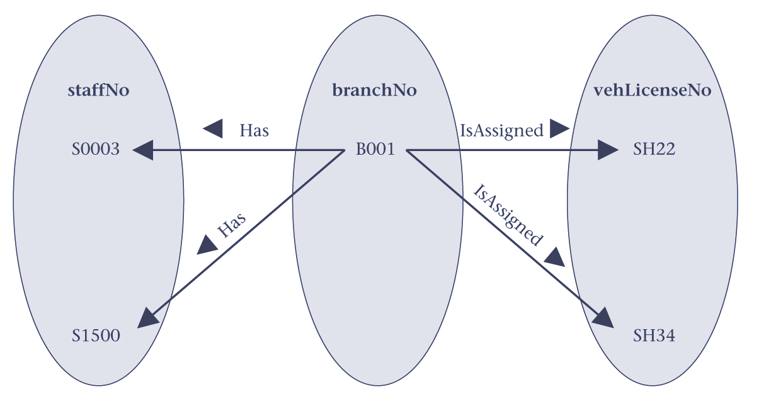
Fan trap
– individual example
Cannot tell which member of staff uses car SH34.

Slide 44
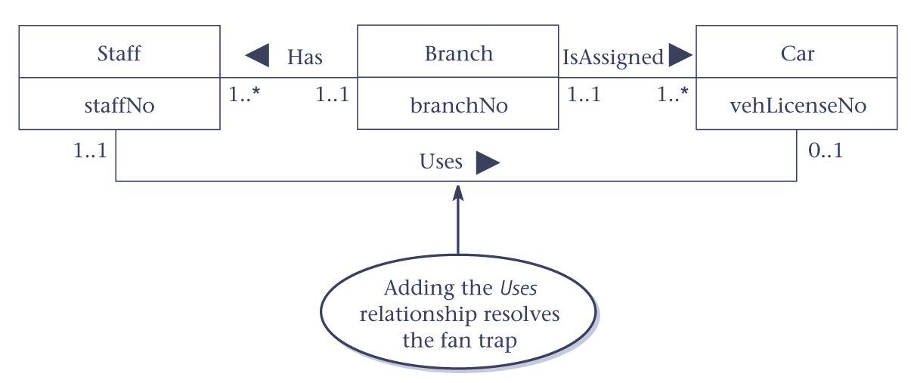
Resolving the fan trap

Slide 45
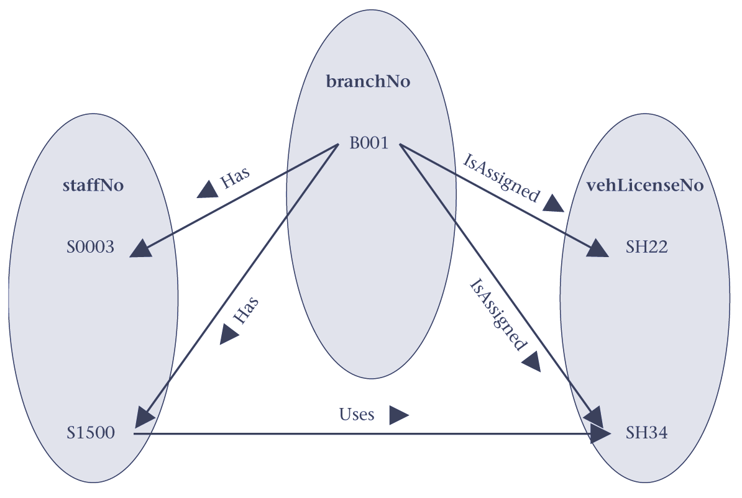
Fan trap resolved – individual example
Can now tell which car staff use.

Slide 46
Problems with ER models
Chasm trap
  A model suggests the existence of a relationship between entities, but the pathway does not exist between certain entity occurrences.

Slide 47
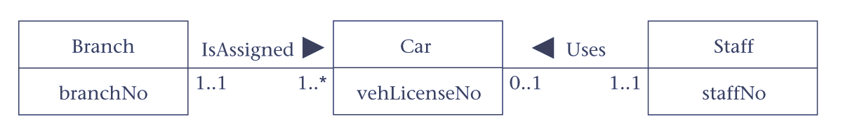
An example of a chasm trap

Slide 48
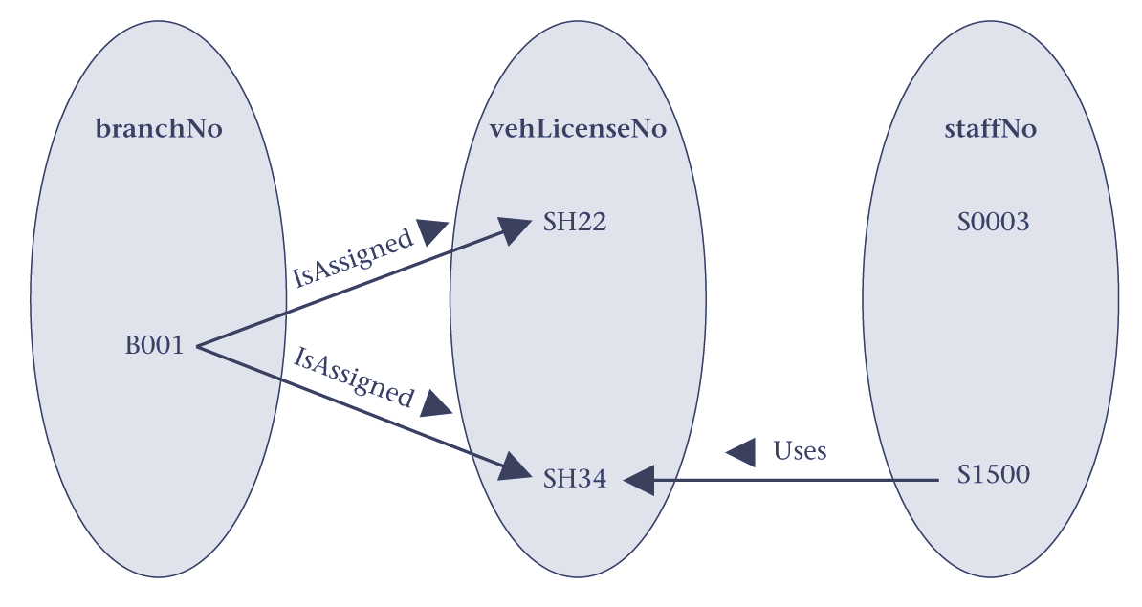
Chasm trap
– individual example
Cannot tell which branch staff S0003 works at.

Slide 49
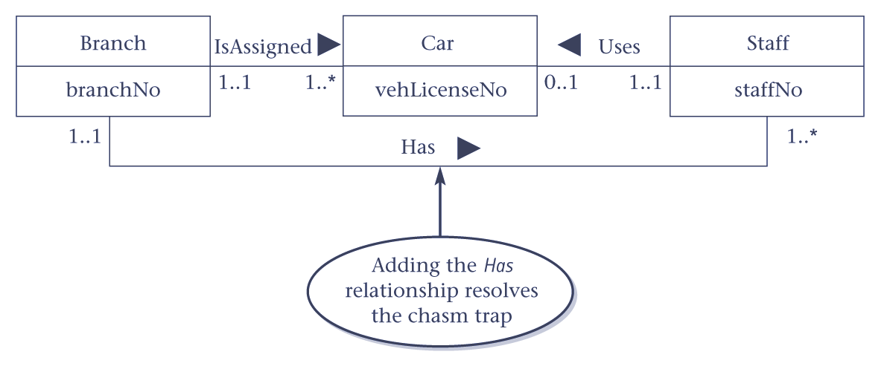
Resolving the chasm trap

Slide 50
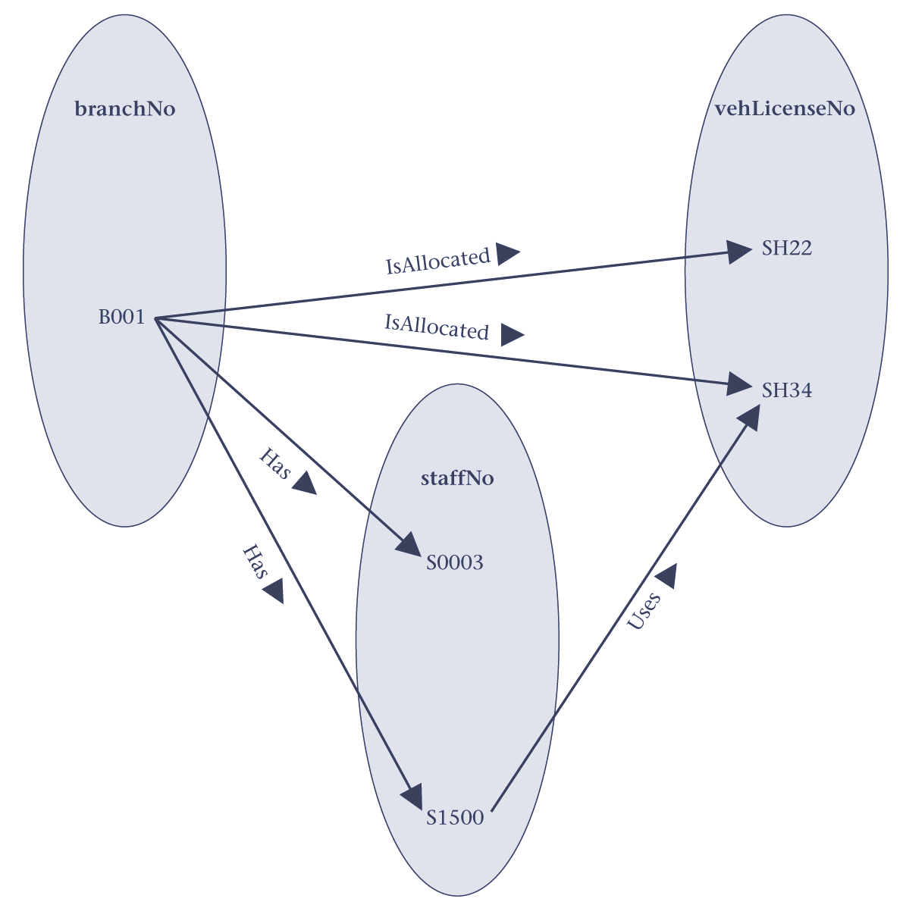
Chasm trap resolved – individual example
Can now tell which branch each member of staff works at.

